Slide 1



Digital piracy of us content
Burton Clausen
DDI-13
November 2025

Slide 2

Table of contents
Project Overview
Exploratory Focuses
Cleaning
Visual Aides
Conclusion
Sources

Slide 3
Overview
Digital piracy is a persistent issue impacting the film, and TV sectors, costing the U.S. billions annually.
Despite availability of legal platforms, high costs and content fragmentation drive piracy.
This exploratory data analysis observes trends and/correlations in pirated video files to identify what categories of video content are the most susceptible.
Exploratory Focuses
Which file was downloaded the most? Which director (collectively)
What is the average amount of time between theatrical release and instances of piracy?
How has piracy grown over the past three decades?
What correlations exist between upload time, the number of downloads, download rate, and IMDb rating?

Slide 4
Cleaning and Preparation
Filtering - only content originating in the United States
Dropping the Dead Weight - eliminate columns which were of no use or held no interest
Formatting - Numbers were converted from strings, dates were converted and given a uniform format, and uniform runtimes were derived from several varying formats.
Removing Duplicates - by title, director, and release date to ensure valid duplicates
Filling the blanks - 'Not available’ for missing strings and mean values for numeric data.
Additional Engineering - New columns performing useful calculations were added before the entirety of the data was organized logically and sorted. Additional filters functions were created for analysis.

Slide 5
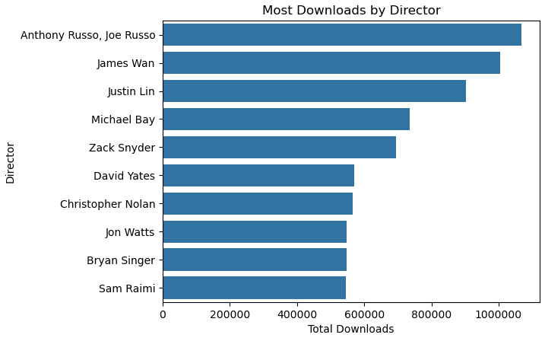
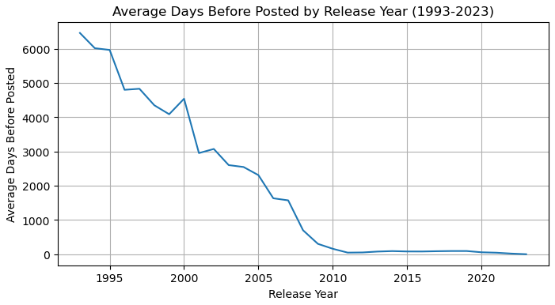
Which director’s collective works have been downloaded the most? –the Russo Brothers
All directors were active in mid-2010s
Many share work in similar genres
Early piracy efforts began in the late 1990s
Average days to upload approaches zero near 2012
The Digital Millennium Copyright Act (DMCA) was enacted in 1998
DCMA

Slide 6
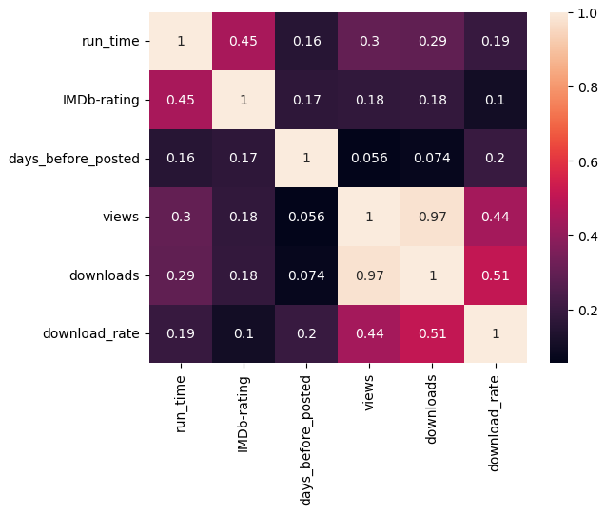
Correlations
Direct correlation with number of downloads compared to views
Not a strong correlation between IMDb rating and download_rate/popularity
Not a strong correlation between days_before_posted and the download_rate …worth exploring

Slide 7
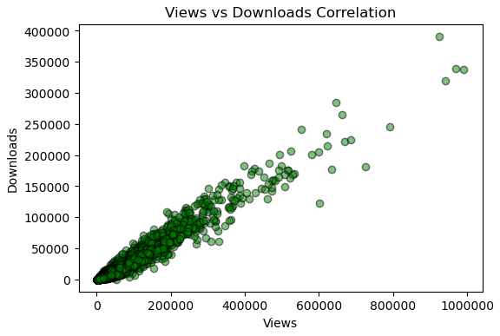
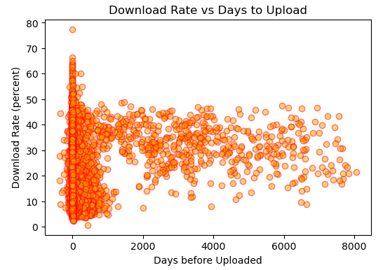
Correlations
LEFT: Representation of the observation above showing a very strong logical connection between views and downloads.
RIGHT: Most popular content IS uploaded shortly after release date, but there is an abundance of data posted after pirating sites gained popularity.

Slide 8
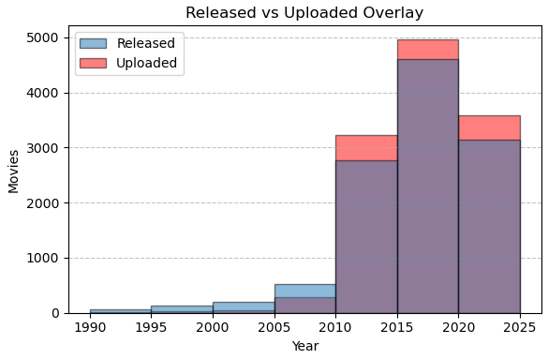
Correlations
TAKEAWAYS:
1 - From 1993 to 2009 the US produced more content than was supported by pirating sites
2 - Large uptick around 2010
Highspeed internet availability
DVD/Blu-ray quality content
3 - Pirated content outpaces Hollywood
3

Slide 9
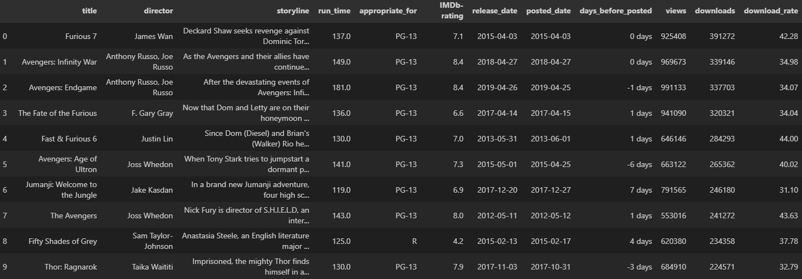
Top 10 Downloads

